Slide 1

MAHENDRA INSTITUTE OF TECHNOLOGY
(AUTONOMOUS)
Mahendhirapuri, Mallasamudram, Namakkal- 637 503
DEPARTMENT OF ELECTRONICS AND COMMUNICATION ENGINEERING
A MAIN PROJECT
TEAM MEMBERS:
Students Name – Register-number
ABINAYAN V 611621406001
DHIWAHAR A 611621406017
GOKILAN S 611621406023
GUIDED BY
DR.ELLAPPAN,M.E,Ph.D
PROFFSSOR/ ECE
Mahendra Institute of Technology

Slide 2
IMAGE SEGMENTATION TECHNIQUE
FOR AUTOMATIC DETECTION
CLASSIFICATION OF AGRICULTURAL
DISEASE USING MATLAB
TEAM MEMBERS
Student Name - Register Number Guide By,
ABINAYAN V 611621406017 DR.ELLAPPAN,M.E,PH.D,
GOKILAN S 611621406023 PROFESSOR/ECE ,
DHIWAHAR A 611621406017 Mahendra Institute Of Technology

Slide 3
Abstract
Agriculture is a key pillar of economic growth and sustenance, especially in India, where it contributes 16% to the GDP and employs nearly 52% of the population. Crop health is essential to ensure productivity and food security. However, diseases in plants can significantly reduce yield and quality. This thesis focuses on an image segmentation technique using MATLAB for the automatic detection and classification of agricultural plant diseases, aiming to enhance efficiency and accuracy over traditional manual monitoring.
Image processing techniques play a vital role in analyzing leaf images to detect disease symptoms early. By using color conversion, grayscale transformation, and histogram equalization, the clarity and contrast of images are improved, making it easier to identify disease-related patterns. Original RGB images are transformed into normalized forms (range 0–1), simplifying processing and improving the precision of subsequent steps.
Automatic detection helps reduce the labor-intensive task of field inspections, especially in large-scale farming. Enhanced images offer better visual inputs for algorithms to isolate and analyze disease-affected areas. This method also benefits from computer vision applications found in other domains such as remote sensing and medical imaging.
The research also addresses image enhancement challenges such as poor lighting, contrast degradation, noise, and blurring, which can negatively impact disease detection accuracy. Techniques like histogram equalization are applied to balance pixel intensities and reveal hidden details in low-quality images.

Slide 4
Introduction
The agricultural land mass has several uses in the modern world, beyond only producing food. Productivity in agriculture has a major role in the Indian economy. As a result, plant disease identification is crucial in the agricultural industry. Using an automated disease detection approach can help identify plant diseases in their very early stages. The current approach for detecting plant diseases involves professionals identifying and detecting the illnesses with their naked eyes .
Visual diagnosis of plant diseases is more time-consuming, less accurate, and only practical in certain situations. On the other hand, using an automated detection approach will save time, effort, and improve accuracy. Image processing is utilised to quantify disease-affected regions and ascertain the variation in colour of the afflicted area.
The technique of splitting or organising a picture into distinct sections is known as image segmentation. There are several picture segmentation techniques available today, ranging from basic holdover approaches to sophisticated colour image segmentation techniques. These components often relate to things that are simple for individuals to distinguish and perceive as distinct entities. [2, 3]. Since computers are incapable of sophisticated object recognition, a wide variety of techniques have been devised to segment pictures. The image different attributes serve as the basis for the segmentation procedure.
A number of factors, including disease kind, crop susceptibility, environmental conditions, and management strategies, may influence how diseases impact agricultural productivity.

Slide 5
History of Digital Image Processing
When pictures were initially sent between London and New York via undersea cable, the newspaper business was one of the first to exploit digital image data. The time it took to send an image across the Atlantic dropped from more than a week to less than three hours with the advent of the Bartlane cable picture transmission system in the early 1920s. After being encoded for cable transmission, images were printed with specialised equipment and then reconfigured.
Some of the early difficulties in improving the visual quality of these early digital images were related to the choice of printmakers and the distribution of intensity levels. In addition, because processing digital images requires so much computing power and storage, progress in the field of digital imaging has depended on the growth of digital computers and related technologies such as data storage, display, and During the 1940s, when the first digital computers were developed, digital imaging get started.
Some of the early difficulties in improving the visual quality of these early digital images were related to the choice of printmakers and the distribution of intensity levels. In addition, because processing digital images requires so much computing power and storage, progress in the field of digital imaging has depended on the growth of digital computers and related technologies such as data storage, display, and During the 1940s, when the first digital computers were developed, digital imaging get started.

Slide 6
Image processing
Digital image processing is the technology of processing digital images using a variety of computer methods. This procedure can produce images or a collection of representative qualities or properties of the source images. Applications for digital image processing are often found in robotics,intelligent systems, medical imaging, remote sensing, photography, and forensics. DIP is concerned with an image that is made up multiple image points.
These image points, also known as pixels, include spatial coordinates that specify their position in image as well as intensity (or gray level) values. A colourful image contains more dimensional information than a gray image because red, green, and blue values are generally used in diverse combinations to reproduce the image's hues in real life.

Slide 7
Fundamentals steps in DIP system
Image acquisition- It could be as simple as already receiving a digital image.
Image enhancement - It is among the simplest and most interesting features of enhancing digital images. The idea is to bring out obscured details in the image, or simply highlight specific features of interest. Image enhancement is a very personal aspect of image processing.
Image restoration- Enhancing the image look is the aim. This is an objective approach in that image restoration techniques typically rely on mathematical or probabilistic image processing models. In contrast, enhancement is based on humans' subjective preferences for what constitutes a “good” enhancement outcome.
Colour image processing- This is a growing field due to the widespread use of digital images on the Internet. Colour image processing is primarily concerned with colour models and their implementation in image processing applications.

Slide 8
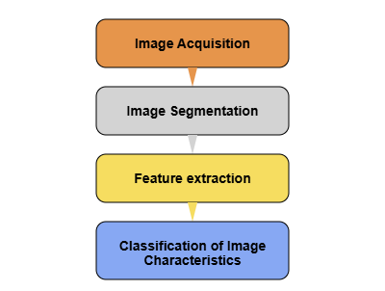
Methods of Disease Detection
The plant disease detection system procedure mainly consists of four phases. Images are acquired during the first phase using a digital camera, a mobile device, or the internet. The image is divided into varying numbers of clusters in the second phase, each of which can be treated using a different technique. The methods for feature extraction are covered in the following phase, and disease classification is covered in the final step.
Phases of plant disease detection system

Slide 9
Convolutional Neural Network
Machine learning includes convolutional neural networks, also known as convnets. It is a subset of the several artificial neural network models that are employed for diverse purposes and data sets. A CNN is a particular type of network design for deep learning algorithms that is utilized for tasks like image recognition and pixel data processing.Three layers make up a convolutional neural network: the convolutional layer, the pooling layer, and the fully connected layer .Using a filter, the convolutional layer scans the images one or more pixels at a time to create an activation map. The convolutional layer's data is stored more effectively by the pooling layer by reducing the amount of data it generates. Fully linked input layer. In order to predict the correct label, the first fully connected layer applies weights to the feature analysis inputs. In the end, the fully connected output layer provides the probability for each label.

Slide 10
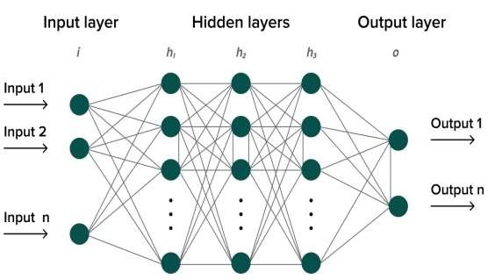
Convolution neural network

Slide 11
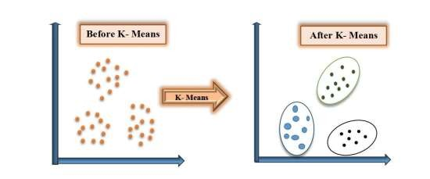
K- Clustering methodology
It is an iterative process of assigning each data point to a group and gradually clustering data points based on similar features. The goal is to minimize the sum of the distances between the data points and the cluster centroid in order to determine which group each data point should belong to. We divide a data space into K clusters and assign each a mean value. The data points are assigned to the clusters with the highest mean value.
K- Clustering Algorithm

Slide 12
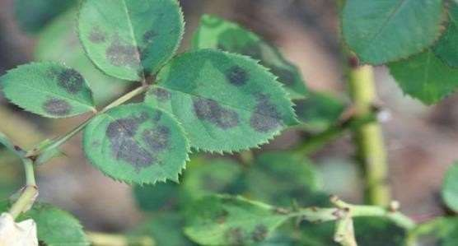
DETECTION AND CLASSIFICATION OF AGRICULTURAL LEAF DISEASES USING HISTOGRAM TECHNIQUE
Productivity in agriculture contributes significantly to the economy. The factors contributing to the significance of plant disease detection in the agricultural industry, as plant diseases are frequently present. The quality, quantity, or productivity of the corresponding crops are adversely affected, and plants suffer serious consequences if necessary steps are not taken in this area. Rose plants are afflicted by the hazardous illness known as little leaf disease.
Image of infected leaf affected by the pathogens

Slide 13
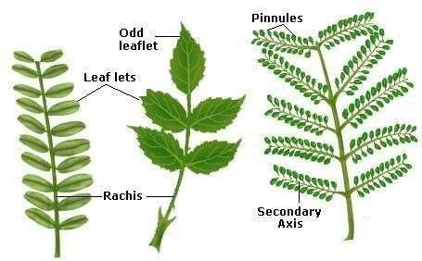
Biology point of view
Much work has been done in the field of leaf recognition to extract generic features or recognize several item groups. When recognizing certain domains, the system performs better since it takes into consideration the special traits that fall under this group. Despite the project high level of technicality, working with leaves has a biological undertone. It is necessary to acquire and understand very fundamental information about leaves from the viewpoint of how scientists
Leaf features

Slide 14
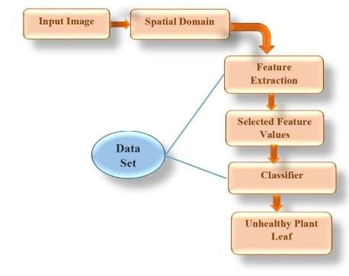
Proposed methodology
Digital cameras are used to capture images of diverse leaves. Additional picture pre- processing methods are used following the acquisition of those images.
Block diagram of proposed approach

Slide 15
Implementation Details
Identifying the disease at its primitive stage and suggesting that pesticides, names and quantity of fungicides are very emerging needs of modern agriculture. In traditional agriculture, diseases are only identified by real-time observation, but today the daily area covered by any type of fruit field is increasing, so it is not possible to identify diseases by the only real-time observation.
Nowadays most of the people doing service also take an interest in different types of flower farming but they don’t have knowledge of conventional agricultural methodology. They need a special type of help and support system to become successful in agriculture. If these farmers will use the proposed system, they can start spraying applications remotely if disease probability is severe. This approach can also be developed using normal techniques like JAVA, but using MATLAB gives the efficient and effective result. As the main focus of this application is user-friendly, this application is designed in such a way that it supports the multilingual concept. This application is helpful for farmers and laboratories where they can easily protect their crops and there will be an increase in growth production growth.

Slide 16
Software Implementation detail MATLAB
For numerical computing, data analysis, visualization, and algorithm creation, MATLAB (short for matrix laboratory) is a high-level programming language and development environment that is extensively used in the scientific and engineering areas. It was first created by Math Works and made public in 1984.These toolboxes cover a wide range of topics, including machine learning, statistics, control systems, optimisation, signal processing, and more. Users can easily complete intricate calculations and analyses thanks to the functions and algorithms contained in each toolbox that are designed for particular tasks within that domain. One needs an effective understanding of MATLAB's syntax, functions, and toolboxes in order to utilize it successfully. Practice, online resources, official documentation, and lessons offered by MathWorks, the firm that created MATLAB, are all ways to learn this. Additionally,
MATLAB enables users to construct interactive applications and interfaces for their MATLAB code by supporting the development of graphical user interfaces (GUIs).

Slide 17
Result analysis
Disease management is a challenging task. Mostly diseases are seen on the leaves or stems of the plant. Precise quantification of these visually observed diseases, pests, traits has not studied yet because of the complexity of visual patterns. Hence there has been increasing demand for more specific and sophisticated image pattern understanding. In the following proposed method we have taken the samples of some plant leaves for example rose and tomato by using histogram equalization method in spatial domain we are going to find from which part the leaves are getting rotten or to detect healthy and unhealthy leaf of plant and as histogram smoothing is a spatial domain method that produces an output image with a uniform distribution of pixel intensities, which means that the histogram of the output image is systematically smoothed and stretched. This approach usually works for the image enhancement paradigm due to its simplicity and relatively better than other traditional methods.

Slide 18
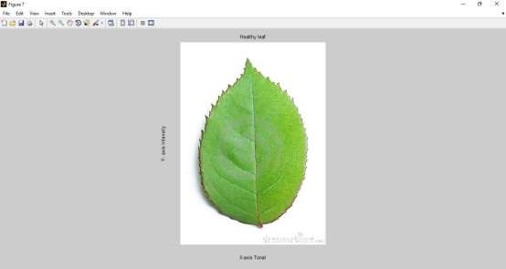
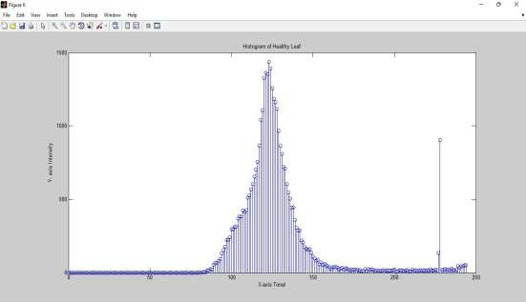
Outputs
Shows the rose healthy used in the experiment
Shows the Histogram of Rose healthy leaf in which Y-Axis represents the intensity whereas X-Axis represents the tonal

Slide 19
Source code
Prepare Your Dataset
Organize your images in folders like this on your local machine:
PlantDataset/
├── Blight/
│ ├── img1.jpg
│ └── img2.jpg
├── Rust/
│ ├── img3.jpg
├── Healthy/
│ ├── img4.jpg
└── Spot/
├── img5.jpg
Each folder name is the class name (disease).
# ✅ INSTALL DEPENDENCIES

Slide 20
# 📁 UPLOAD ZIP DATASET
print("📤 Please upload a ZIP file containing class folders like Blight/, Rust/, Healthy/...")
uploaded = files.upload()
# 🔓 UNZIP
for name in uploaded.keys():
zip_name = name
break
dataset_dir = "PlantDataset"
os.makedirs(dataset_dir, exist_ok=True)
with zipfile.ZipFile(zip_name, 'r') as zip_ref:
zip_ref.extractall(dataset_dir)
# ✅ IMAGE PREPROCESSING

Slide 21
def extract_features(img):
hsv = cv2.cvtColor(img, cv2.COLOR_BGR2HSV)
hist = cv2.calcHist([hsv], [0, 1, 2], None, [8, 8, 8], [0, 180, 0, 256, 0, 256])
return cv2.normalize(hist, hist).flatten()
# 🧠 LOAD DATASET
X, y = [], []
labels = []
print("📊 Extracting features from dataset...")
for label in os.listdir(dataset_dir):
class_path = os.path.join(dataset_dir, label)
if not os.path.isdir(class_path): continue
labels.append(label)

Slide 22
print(f"✅ Total images loaded: {len(X)}")
# 🧪 TRAIN-TEST SPLIT AND MODEL TRAINING
X_train, X_test, y_train, y_test = train_test_split(X, y, test_size=0.2, random_state=42)
model = RandomForestClassifier(n_estimators=100, random_state=42)
model.fit(X_train, y_train)
# 📉 EVALUATE MODEL
print("\n📈 Classification Report:")
print(classification_report(y_test, model.predict(X_test)))

Slide 23
# 💾 SAVE MODEL
with open("plant_disease_model.pkl", "wb") as f:
pickle.dump(model, f)
Upload and Predict New Test Image
Now you can run this SECOND BLOCK to upload a test image and see the result:
# 📁 CREATE OUTPUT DIRECTORY
os.makedirs("outputs", exist_ok=True)
# 📤 UPLOAD A TEST IMAGE
uploaded = files.upload()
file_name = list(uploaded.keys())[0]
img = cv2.imread(file_name)
img = cv2.resize(img, (256, 256))
filename = os.path.splitext(os.path.basename(file_name))[0]

Slide 24
# 🖼️ SHOW INPUT IMAGE
input_path = f"outputs/input_{filename}.jpg"
cv2.imwrite(input_path, img)
print(f"\n🖼️ Input Image:")
display(PILImage.open(input_path))
# 🧪 SEGMENT
segmented = segment_image(img)
seg_path = f"outputs/segmented_{filename}.jpg"
cv2.imwrite(seg_path, segmented)
print(f"\n🧬 Segmented Image:")
display(PILImage.open(seg_path))

Slide 25
References
1. Crow W. T., & Dunn R. A. (2005). Introduction to Plant Nematology, ENY-016, Gainesville: University of Florida Institute of Food and Agricultural Sciences.
2. Crow W. T., & Woods F. E. (2007). Nematode Assay Laboratory, ENY-027,
Gainesville: University of Florida Institute of Food and Agricultural Sciences.
3. Gyeltshen J., & Hodges A. (2006). Fuller Rose Beetle, Naupactus godmanni (Crotch) (Insecta: Coleoptera: Curculionidae),EENY-375,Gainesville: University of Florida Institute of Food and Agricultural Sciences.
4. Park Brown, S. (2007). Growing Roses in Florida, CIR344, Gainesville:
University of Florida Institute of Food and Agricultural Sciences.
5. Kobayashi. K, (2002). "Birth of a Digital Photo Telegraph-the Bart lane System" Journal of the Institute of Image Electronics Engineers of Japan, 31(2), ISSN:
0285-9831.

Slide 26
THANK YOU

